Slide 1
Identifying fully convective m-dwarfs in tess sectors 1 and 2
SURP 2021
By: Avidaan Srivastava
Advisor: Dr. Ji Wang

Slide 2
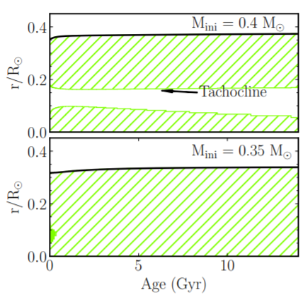
Overall Objective
Understand the origins of stellar magnetism
Tachocline: Boundary between convective and radiative regions of a star
Might play a role in creating Stellar Magnetism in Low Mass Stars (M-dwarfs here)
Doesn’t exist in Fully Convective stars
(Bochanski, Cantiello, Wang)

Slide 3
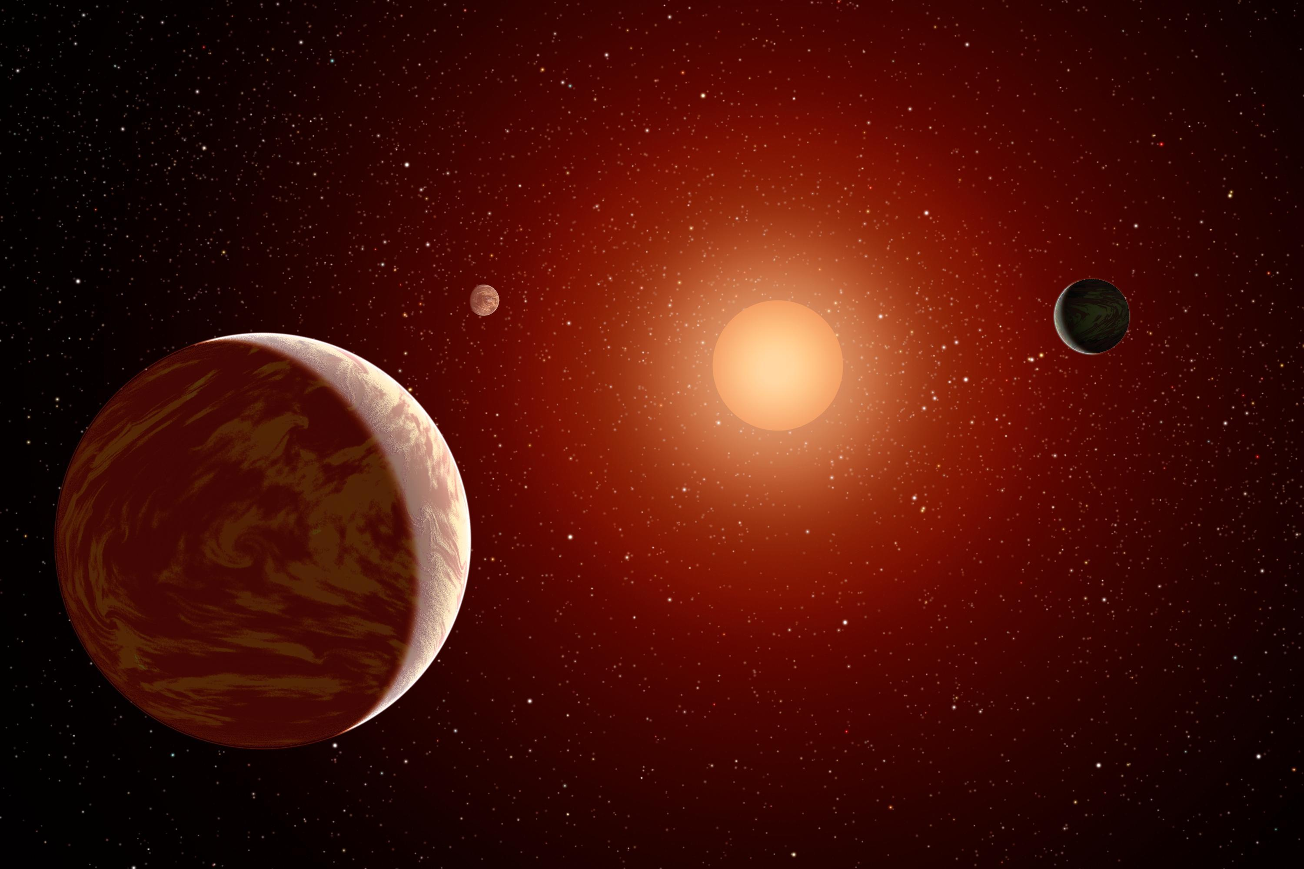
Finding the stars
Find catalogue of all flaring stars in TESS (Transiting Exoplanet Survey Satellite) sectors 1 and 2
No mass listed – Derive it!
Temperature + Radius Luminosity Mass
M-dwarfs have mass < 0.6 M_{sun}
Only keep stars with Rossby Number
( P_{rot} / T_{conv} ) < 0.1

Slide 4
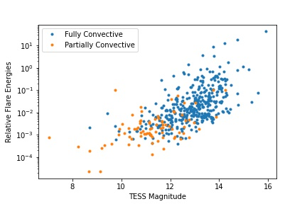
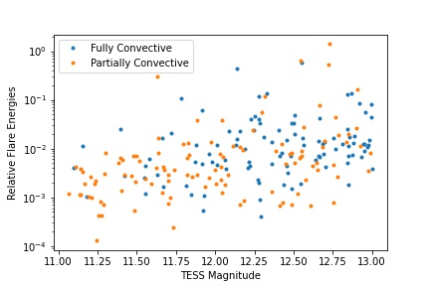
Separating the Stars
Assume cutoff mass as 0.4 Msun
Use TESS Input Catalog identifier (TIC) and Lightkurve to obtain the lightcurves for all the stars
Exclude possible flares and avoid selection bias
For the cutoff mass, create a Cumulative Distribution Function (CDF) for Relative Flare Energies and Spot Filling Factors for both types of stars
Apply Kolmogorov-Smirnov (KS) test – determine how different two CDFs are

Slide 5
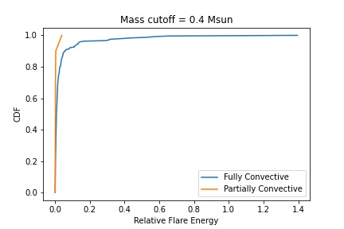
Relative Flare Energy
Relative Flare Energy ~ Flare Amplitude²
High Flare Energy, high magnetic flux
KS statistic = 0.482; KS p-value = 5.56 * 10⁻⁵

Slide 6
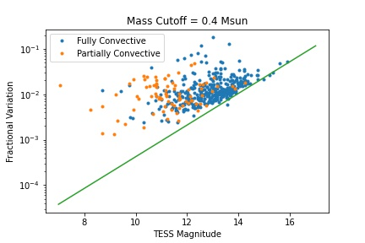
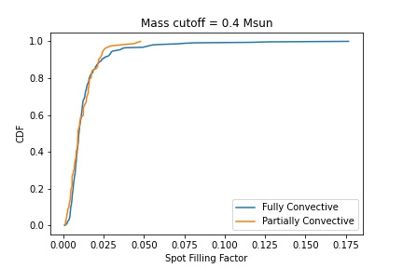
Spot Filling Factors
Spot Filling Factor: % of surface covered with spots
Fractional Variation Spot Filling Factor
Spot Filling Factor = (Frac. Variation² – Y²)^{.5}
KS statistic = 0.105; KS p-value = 0.419

Slide 7
Next steps…
Repeat the process for multiple cutoff masses
Locate the transition point where Fully Convective stars turn into Partially Convective stars
Reduce TESS data beyond sectors 1 and 2

Slide 8
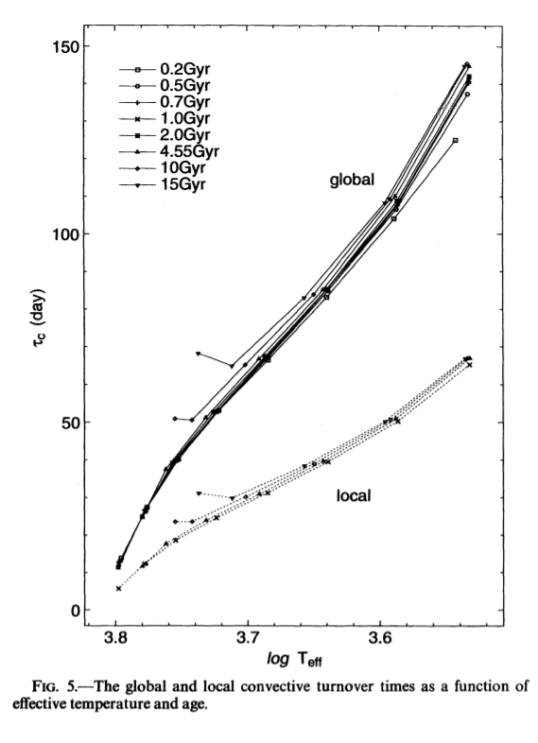
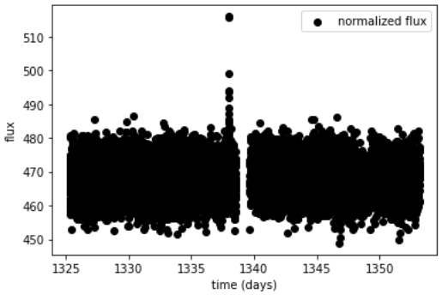
(Kim & Demarque, 1996)

